Slide 1
FPGA-Accelerated HFT Edge Device
Project Type: Research Project
05/01/2025
Team Leader: Aneesh Poddutur
Bharath Chandar Natarajan
Yiyun Wang (Sky)
Shraddha Sahoo
Dheeraj Krishna Chaitanya Karanam

Slide 2
Target Problem Refresher
What is High Frequency Trading (HFT)?
  Algorithmic trading leveraging high-throughput, low-latency compute.
  Executes numerous financial transactions at extremely high speeds.
  Exploits small price movements (e.g., commodity price mismatches, options pricing recalculations).
The Challenge:
  Ultra-low latency is critical for processing market data.
  Proximity to exchanges impacts latency due to cable length delays.
  Not all traders can establish locations near exchanges.
Our Focus:
  Develop a portable, low-power edge device to minimize latency.
  Enable HFT for diverse users (e.g., large firms like Citadel or individual traders like Jeremy).

Slide 3
Why Edge Devices for HFT?
Motivation:
  Traditional HFT systems rely on direct Ethernet connections and high-speed protocols (PCIe, FPGA/ASIC).
  Distant trading locations increase latency due to longer cable lengths.
  Edge devices offer a compact, portable solution for proximity to exchanges.
Benefits:
  Large Firms: Place edge devices near exchanges for preliminary processing.
  Individual Traders: Enable low-volume HFT in remote settings (e.g., dorm rooms).
  Low Power & Portability: Reduces infrastructure needs, democratizes access to HFT.

Slide 4
Methodology Overview
Original Core Approach:
  Implement FPGA-based hardware computation for Black-Scholes pricing model.
  Build SPI bus for FPGA.
  Build SPI sending/receiving functionality in ESP32.
  Use wireless communication to send market data to the edge device, or generate test data from the ESP32 for benchmarking.
System Components:
  ESP32 Microcontroller: Handles wireless data reception and coordination.
  Diligent A7 35T FPGA: Executes customized, parallelized, deterministic trading algorithms.
  External Financial API: Provides real-time market data for processing.
ESP32
fetches data from Financial API via WIFI, or generates dummy data
FPGA interface
ESP32 gets data for logging
SPI Module
Computation Module

Slide 5
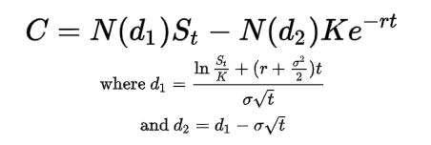
Black-Scholes Equation
Inputs:
Spot price (S_{t})
Strike price (K)
Risk-free rate (r)
Volatility (σ)
Time to maturity (T)
Outputs:
Call option price (C)
“gives a theoretical estimate of the price of European-style options and shows that the option has a unique price given the risk of the security and its expected return” - https://en.wikipedia.org/wiki/Black%E2%80%93Scholes_model

Slide 6
FPGA RTL
RTL Describes how data flows between registers and the combinational logic that processes it.
Specifies:
Data operations (add, multiply, divide, etc.)
Control flow (if, case, etc.)
Timing (clocked or combinational)
LUTs
RTL Code
(System Verilog)
Logic Synthesis
DSPs
FPGA Fabric
Flip-flops
Notes:
RTL = Hardware "Blueprint"
➡ Written in HDL (Hardware Description Languages) like SystemVerilog or VHDL.
➡ Synthesized into actual FPGA hardware structures: LUTs, DSP blocks, Flip-Flops, etc.
Describes how data flows between registers and the combinational logic that processes it.
Specifies:
Data operations (add, multiply, divide, etc.)
Control flow (if, case, etc.)
Timing (clocked or combinational)
Here’s a high-level view of how an RTL design gets implemented on an FPGA.
We start with RTL code, typically written in languages like SystemVerilog or VHDL.
At this level, we describe what operations should happen — for example, additions, multiplications, divisions — and how data flows between these operations. We also specify the control flow and, if desired, the timing.
This RTL code is then passed to the logic synthesis toolchain — for example, Vivado for Xilinx FPGAs.
Synthesis converts our abstract RTL description into concrete digital hardware structures.
These include:
LUTs (Look-Up Tables), which implement combinational logic,
DSP blocks, which efficiently perform arithmetic operations like multiplication and addition,
And Flip-Flops, which store data and synchronize operations in clocked designs.
After synthesis, the hardware structures are mapped onto the FPGA fabric — the physical silicon area where the design will actually run.
So, in summary, RTL serves as the blueprint for designing digital hardware that will be physically implemented using the FPGA’s configurable resources.
By using RTL instead of high-level synthesis or software, we gain full control over how computations are implemented, allowing us to optimize for performance, latency, and resource utilization.

Slide 7
Current Progress
Completed WiFi provisioning for getting the system connected to the internet.
Wrote external API calls for Alpha Vantage, Polygon, FMP, FINNHUB, TIINGO, and FRED
Finished benchmarking locally on ESP32
Completed hex lookup table and RTL for Normal CDF module, simulated and verified
Completed modules for fixed point addition, subtraction, other functions using lookup tables.

Slide 8
Current Progress
Local ESP32 Benchmark
 | d1 | d2 (assuming d1 is already computed) | Normal CDF | C
Trial 1 | 417 us | 75 us | 277 us | 668 us
Trial 2 | 127 us | 65 us | 263 us | 377 us
Trial 3 | 128 us | 69 us | 83 us | 341 us
Average | 284 us | 69.67 us | 209.67 us | 462 us

Slide 9
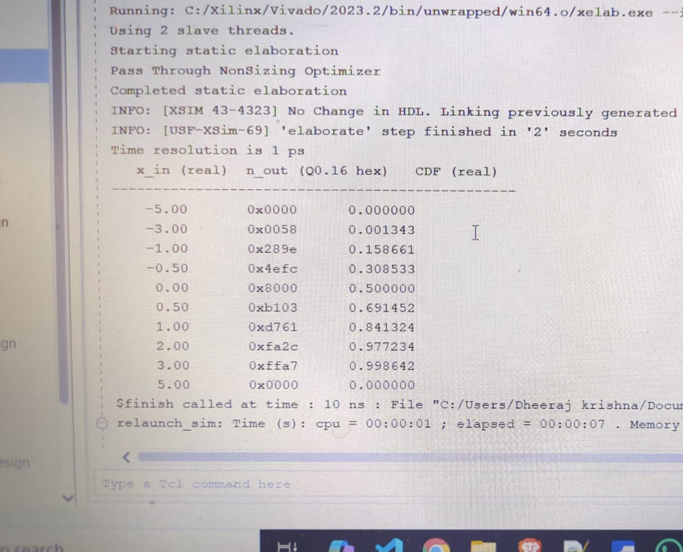
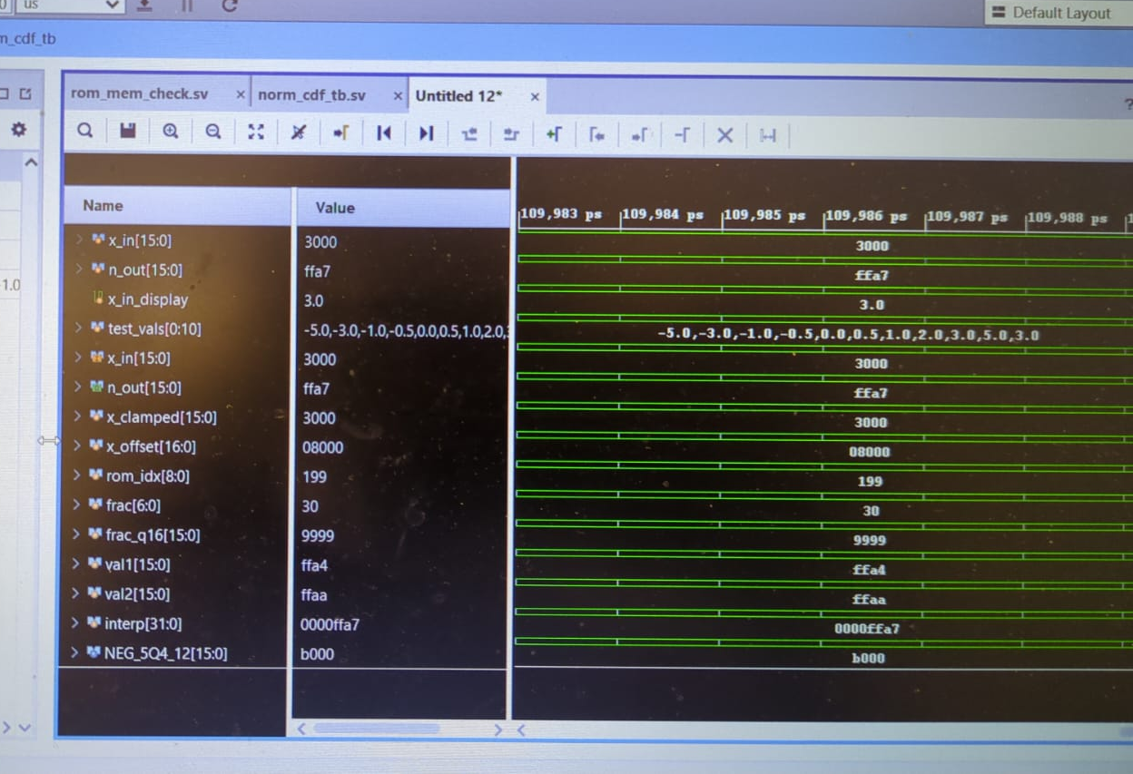
Current Progress
Development RTL (norm_cdf.sv)

Slide 10
Roadblocks and Roadmap
Roadblocks
The external API is written and functional, but there is too large of a delay in calling pricing data.
The number of API calls that can be made in a day are far too low, making live tracking infeasible.
Roadmap
Integration and Synthesis of Aggregate Black-Scholes Computation
  We need to finish testing the mathematical operation blocks to ensure functionality and synthesizability, and integrate them in a top module.
All SPI communication
  There may not be enough time to finish the SPI functionality of the project. In this case, we will focus on the Black-Scholes Computation and doing an in-depth analysis on the timing differences and speedup achieved by switching to an FPGA solution from an embedded system.

Slide 11
Thank You

